Slide 1
Big-O Notation
Alireza Davoodi

Slide 2
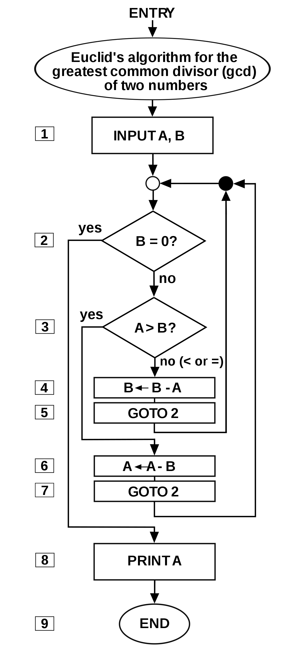
Recap
Algorithm
Input and output of an Algorithm
Input size
Different operations used in an algorithms
repetition, condition, assignment, etc
Different ways to implement an algorithm
Iterative algorithms, Recursive algorithm, etc
Image from Wikipedia

Slide 3
Today
We want to have a mechanism/method for being able to
Estimate or reason about how much time we think an algorithm is going take to solve a problem of a particular size.
If we increase the size of the input of the algorithm what does that do in terms of the increase in the amount of time that the algorithms needs to solve the problem.

Slide 4
Today
We want to have a mechanism/method for being able to
Estimate or reason about how much time we think an algorithm is going take to solve a problem of a particular size.
If we increase the size of the input of the algorithm what does that do in terms of the increase in the amount of time that the algorithms needs to solve the problem.
Big-O

Slide 5
Learning Goals
How efficient is my algorithm?
By efficiency we mean how much Time and Space is needed
We focus on time
How fast my algorithm is going to run and how we can reason about that
Orders of growth and what it means
Asymptotic Big-O Notation
Explore different Complexity classes of algorithms

Slide 6
Time Efficiency
Algorithm Time Efficiency:
How long an algorithm is going to take to solve a problem?

Slide 7
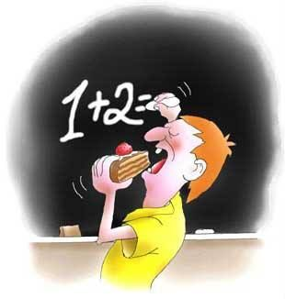
Time Efficiency
Algorithm Time Efficiency:
How long an algorithm is going to take to solve a problem?
Source: https://cafetalk.com/column/read/?id=49297

Slide 8

Time Efficiency
Algorithm Time Efficiency:
How long an algorithm is going to take to solve a problem?
Source: https://imgflip.com/i/121z4q
Source: https://cafetalk.com/column/read/?id=49297

Slide 9
Challenge
One Problem – Varying input sizes
One Problem - Multiple choices of Algorithms
Iterative – Recursive
Divide & Conquer vs. Greedy vs. etc
One Algorithm - Multiple choices of Implementation
For-loop or While-loop
If, Switch

Slide 10
Challenge
One Problem – Varying input sizes
One Problem - Multiple choices of Algorithms
Iterative – Recursive
Divide & Conquer vs. Greedy vs. etc
One Algorithm - Multiple choices of Implementation
For-loop or While-loop
If, Switch
Then, how can we reason about/evaluate how efficient an algorithm is for a problem

Slide 11
A good approach
Can differentiate between running time of varying algorithms
Should be (as much as possible) independent from the implementations
Should be independent from the computer it runs on
Should be predictive about relationship between the size and time

Slide 12
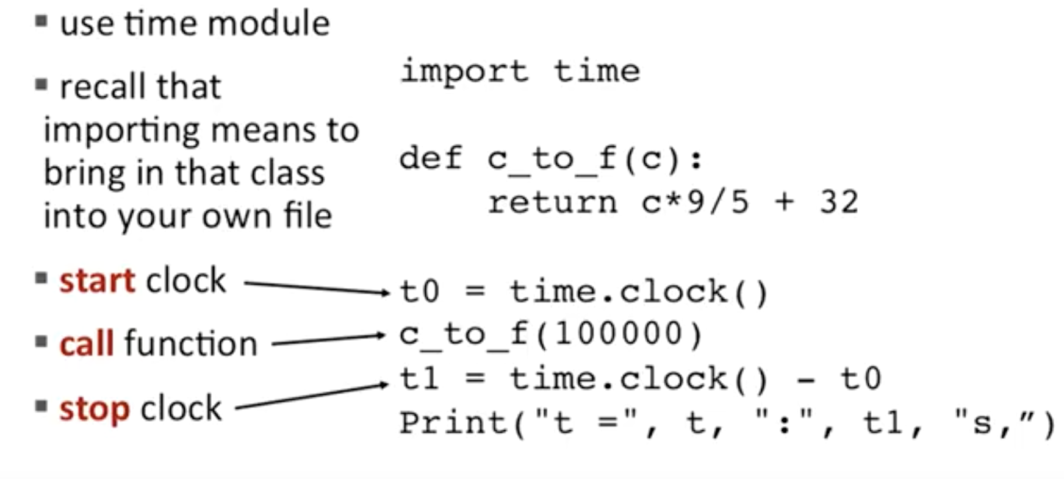
Approach 1: Timing
1) Measure with a timer:
Scientifically: timer, multiple times, measure, making average, …

Slide 13
Timing Approach: Works or not?
Goal: To evaluate efficiency of algorithms for a problem
Does it differentiate between running time of varying algorithms (different algorithms different timing) | YES
Is it independent from the implementations | NO
Is it independent from the computer it runs on | NO
Is it predictive about relationship between the size and time | NO (not so easy)

Slide 14
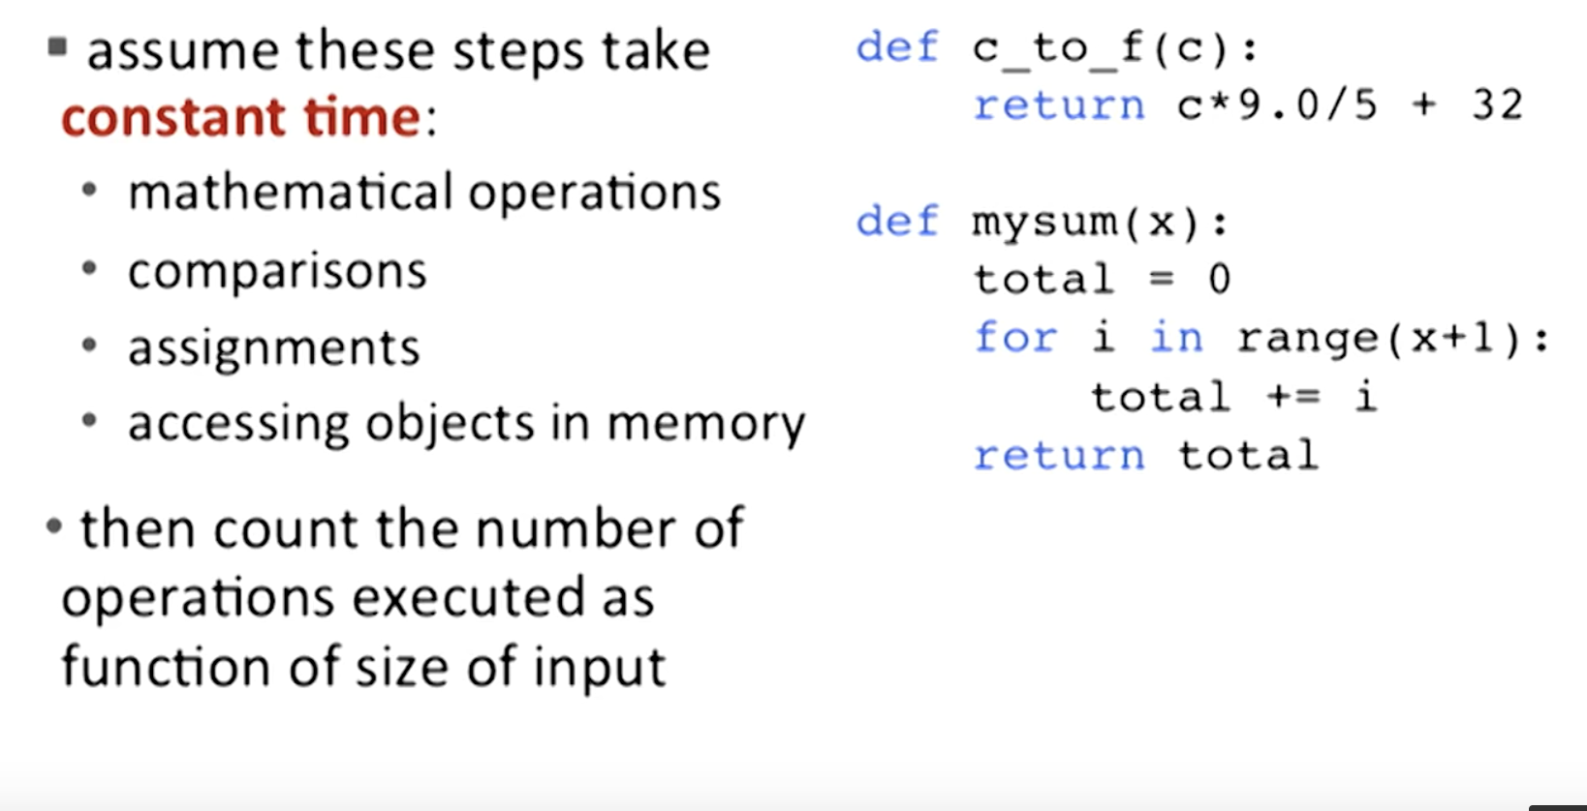
Approach 2: Counting Operations
Count the operations: Count the Mathematical operations, assignments, loops, … as a function of the size of the input.

Slide 15
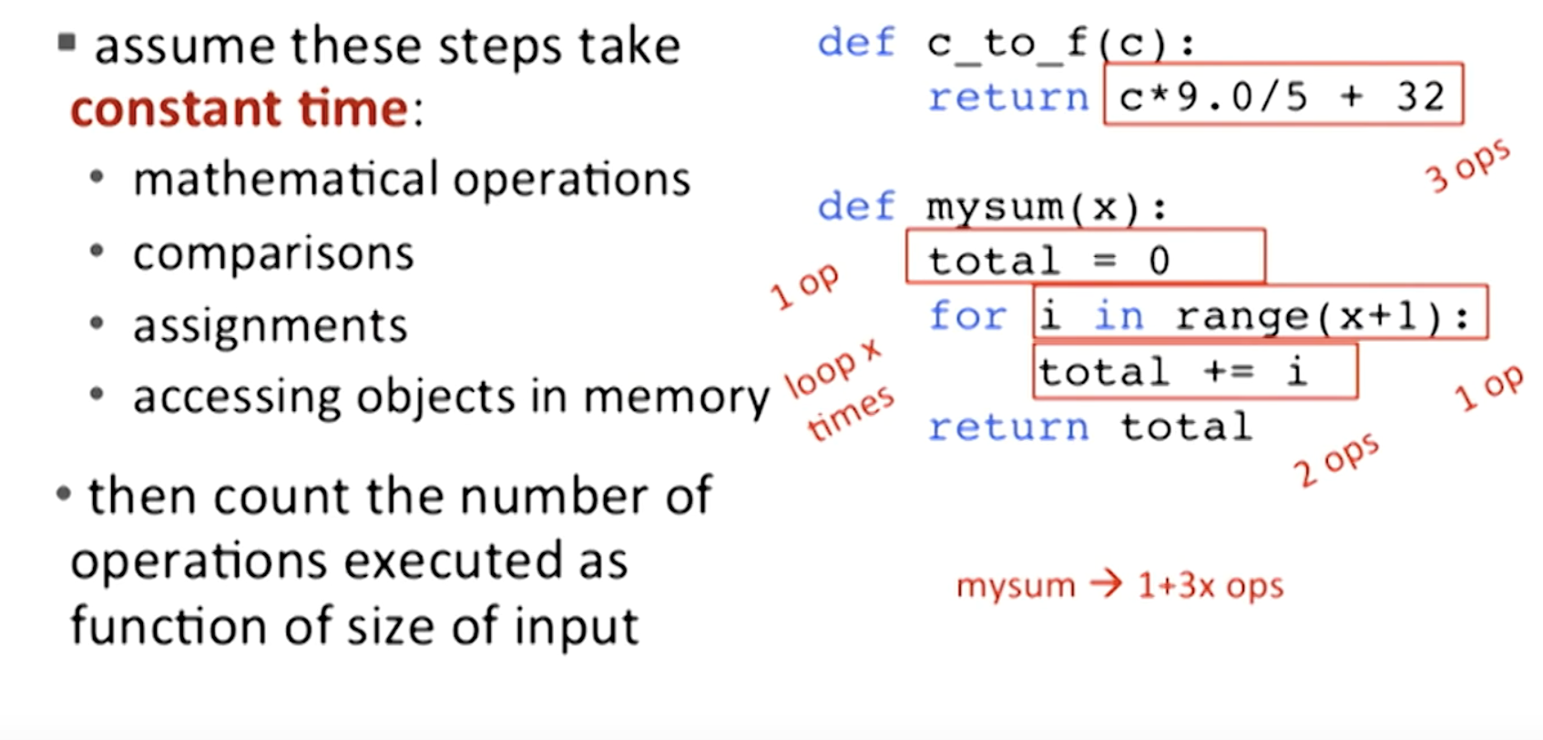
Approach 2: Counting Operations
Count the operations: Count the Mathematical operations, assignments, loops, … as a function of the size of the input.

Slide 16
Counting Approach: Works or not?
Goal: To evaluate efficiency of algorithms for a problem
Does it differentiate between running time of varying algorithms (different algorithms different counting) | YES
Is it independent from the implementations (like a while-loop is different from a for-loop) | NO
Is it independent from the computer it runs on | YES
Is it predictive about relationship between the size and time | YES
Challenge: It is not really clear which operation to count

Slide 17
Approach 3:
Running time as a function of input size:
Input size: N
Running time: T(N) which is a function of input size
Example: T(N) = N²+1
T(5) = 5²+1 = 25+1 = 26
Example: T(N) = N²+3N+100
T(5) = 5²+3*5+100 = 25+15+100 = 140

Slide 18
Example
Associate a "cost" with each statement.
Find the "total cost“ by finding the total number of times each statement is executed.
Algorithm 1 Algorithm 2
Cost (time) Cost (time)
arr[0] = 0; c₁ for(i=0; i<N; i++) c₂
arr[1] = 0; c₁ arr[i] = 0; c₁
arr[2] = 0; c₁
... ...
arr[N-1] = 0; c₁
----------- -------------
Total cost? Total cost?

Slide 19
Example
Associate a "cost" with each statement.
Find the "total cost“ by finding the total number of times each statement is executed.
Algorithm 1 Algorithm 2
Cost (time) Cost (time)
arr[0] = 0; c₁ for i range(N) c₂
arr[1] = 0; c₁ arr[i] = 0; c₁
arr[2] = 0; c₁
... ...
arr[N-1] = 0; c₁
----------- -------------
c₁+c₁+...+c₁: T(N) = c₁ x N (N+1) x c₂ + N x c₁ :T(N) =(c₂ + c₁) x N + c₂

Slide 20
Compare
Algorithm 1: T(N) = c₁ x N
Algorithm 2: T(N) =(c₂ + c₁) x N + c₂
Example: N = 10, c₁ = 1, c₂=1
Algorithm 1: T(N) = c₁ x N = 10
Algorithm 2: T(N) =(c₂ + c₁) x N + c₂ = 21
Example: N = 10000, c₁ = 1, c₂=1
Algorithm 1: T(N) = c₁ x N = 10000
Algorithm 2: T(N) =(c₂ + c₁) x N + c₂ = 20001
It seems we can compare! So what is the issue.

Slide 21
Compare
Algorithm 1: T(N) = c₁ x N
Algorithm 2: T(N) =(c₂ + c₁) x N + c₂
Example: N = 10, c₁ = 1, c₂=1
Algorithm 1: T(N) = c₁ x N = 10
Algorithm 2: T(N) =(c₂ + c₁) x N + c₂ = 21
Example: N = 10000, c₁ = 1, c₂=1
Algorithm 1: T(N) = c₁ x N = 10000
Algorithm 2: T(N) =(c₂ + c₁) x N + c₂ = 20001
It seems we can compare! So what is the issue.
C1 and C2 are Machine, Language, Implementation dependent

Slide 22
What is the solution then?
Analyzing the algorithms Asymptotically

Slide 23
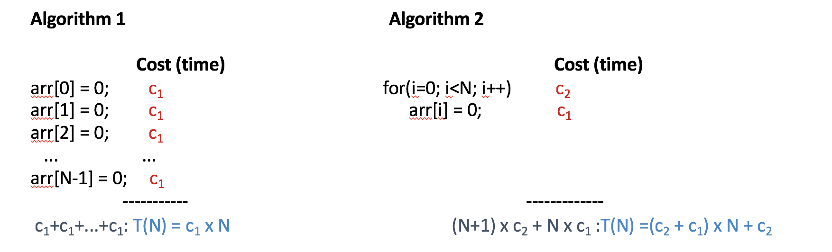
Approach 4: Asymptotic Behavior
Asymptotic Behavior of the Algorithm: We look for the most effective part of the algorithm:
The details of implementation does not matter
Do not care about the parts of the algorithm which are not very effective when the size of the input increases

Slide 24
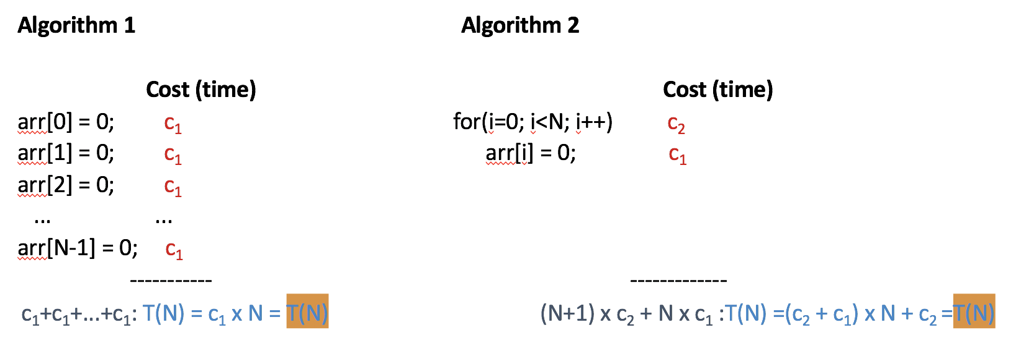
Approach 4: Asymptotic Behavior

Slide 25
Asymptotic Notation: Big-O
Algorithm 1 Algorithm 2
Cost (time) Cost (time)
arr[0] = 0; c₁ for(i=0; i<N; i++) c₂
arr[1] = 0; c₁ arr[i] = 0; c₁
arr[2] = 0; c₁
... ...
arr[N-1] = 0; c₁
----------- -------------
c₁+c₁+...+c₁: T(N) = c₁ x N = T(N) = O(N) (N+1) x c₂ + N x c₁ :T(N) =(c₂ + c₁) x N + c₂ = T(N) = O(N)

Slide 26
Properties of Big-O
No details of implementation
Only contains most effective parts of the algorithm
Instead:
It shows how the algorithm running time increases as the input size increases

Slide 27
Properties of Big-O
No details of implementation
Only contains most effective parts of the algorithm
Instead:
It shows how the algorithm running time increases as the input size increases
Order of Growth
Gives us a pattern how the running time changes when the input size changes

Slide 28
Properties of Big-O
No details of implementation
Only contains most effective parts of the algorithm
Instead:
It shows how the algorithm running time increases as the input size increases
Order of Growth
Complexity Class
defines

Slide 29
Example
How can we analyze an algorithm asymptotically
Time function | Asymptotic Big-O | Complexity Class
N+200 | O(N) | Linear
N²+2N+ 2 | O(N²) | Polynomial
N²+2000N+ 20000 | O(N²) | Polynomial
0.1N* log(N) + 5 | O(NlogN) | Log-Linear
Log(N)+20 | O(logN) | Logarithmic
N²+ 2^{N} | O(2^{N)} | Exponential
100 | O(1) | Constant

Slide 30
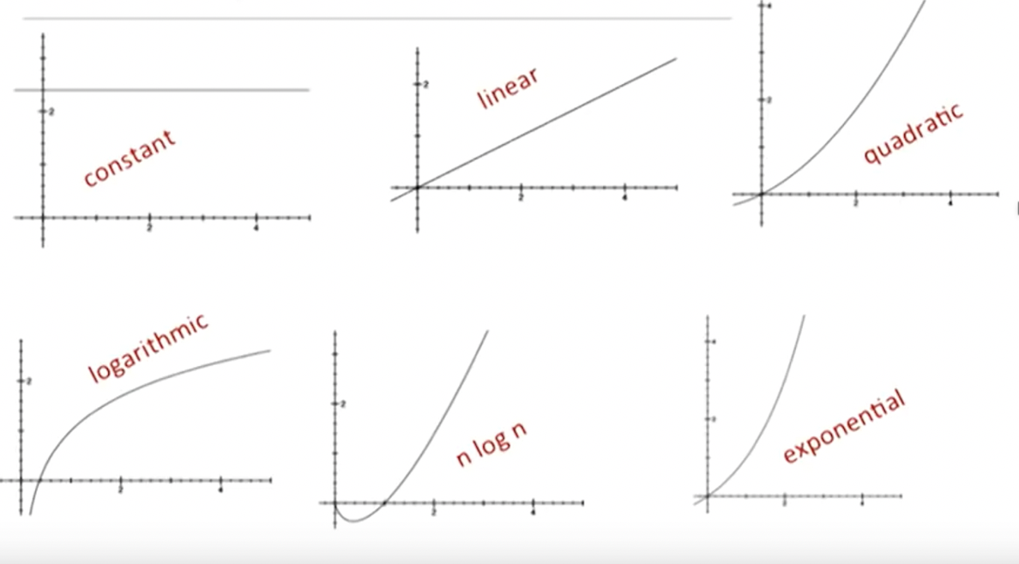
Types of Order of Growth
Order of Growth
Complexity Class

Slide 31

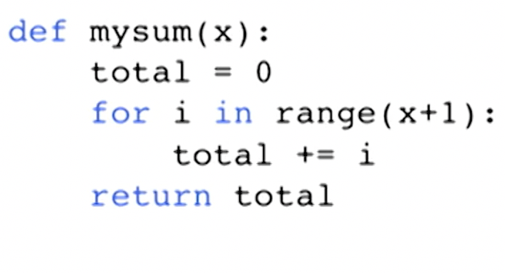
Big-O Notation
Problem
Algorithm
Asymptotic Behavior
Order of Growth
Complexity Classes
Big-O

Slide 32
Types of Analysis
Big-O lets us show the order of growth based on the size of the input
But is there anything else to consider:

Slide 33
Types of Analysis
Big-O lets us show the order of growth based on the size of the input
But is there anything else to consider:
Think about a sequential (linear search) for a student in a classroom
What is the Time Complexity of this algorithm?

Slide 34
Types of Analysis
Big-O lets us show the order of growth based on the size of the input
But is there anything else to consider:
Think about a sequential (linear search) for a student in a classroom
What is the Time Complexity of this algorithm?
O(N): (N size of the classroom = number of students)
What if the student we are looking one is the first one?

Slide 35
Types of Analysis
Big-O lets us show the order of growth based on the size of the input
But is there anything else to consider:
Think about a sequential (linear search) for a student in a classroom
What is the Time Complexity of this algorithm?
O(N): (N size of the classroom = number of students)
What if the student we are looking one is the first one?
O(1)
What about if the student is absent?

Slide 36
Types of Analysis
Big-O lets us show the order of growth based on the size of the input
But is there anything else to consider:
Think about a sequential (linear search) for a student in a classroom
What is the Time Complexity of this algorithm?
O(N): (N size of the classroom = number of students)
What if the student we are looking one is the first one?
O(1)
What about if the student is absent?
O(N)

Slide 37
Types of Analysis
Big-O lets us show the order of growth based on the size of the input
But is there anything else to consider:
Think about a sequential (linear search) for a student in a classroom
What is the Time Complexity of this algorithm?
O(N): (N size of the classroom = number of students)
What if the student we are looking one is the first one?
O(1): Best case
What about if the student is absent?
O(N): Worst case

Slide 38
Types of Analysis
Worst case
Provides an upper bound on running time
An absolute guarantee that the algorithm would not run longer, no matter what the inputs are
Best case
Provides a lower bound on running time
Average case (talk about it later)
Provides a prediction about the running time
Assumes that the input is random

Slide 39
Types of Analysis
Worst case
Provides an upper bound on running time
An absolute guarantee that the algorithm would not run longer, no matter what the inputs are
Best case
Provides a lower bound on running time
Average case (talk about it later)
Provides a prediction about the running time
Assumes that the input is random
We are mainly interested about the Worst-case
Big-O usually means Time Complexity in Worst-case scenario

Slide 40
Example
]
for i = 1 to n do
for j = 1 to n do
sum = sum + 1
1
n times
]
1
n times
1
This example is pretty straightforward. Each loop goes n times, and a constant amount of work is done on the inside.

Slide 41
Question
i = 1
while i < n do
for j = i to n do
sum = sum + 1
i++
Time complexity:
O(n)
O(n lg n)
O(n²)
O(n² lg n)
None of these

Slide 42
Solution
i = 1
while i < n do
for j = i to n do
sum = sum + 1
i++
Count this line
The second sigma is n-i+1
=O=(N²)

